Slide 2
Web-Scraped Phishing URL Analysis Using Google Safe Browsing API
Research Question
How accurately does Google Safe Browsing detect unsafe URLs collected from real-world sources (public sites + threat feeds)?
Most Important Discovery
A significant portion of URLs expected to be unsafe were not detected by the API → clear detection gap.
90-Second Critical Info
Collected real-world URLs (safe + unsafe)
Classified them using Google Safe Browsing
Compared expected vs detected outcomes
Found that detection works for known threats but misses many real-world unsafe URLs

Slide 3
Raw Data Collection
Sources
Safe URLs: BBC, CNN, Wikipedia
Unsafe URLs: OpenPhish, URLhaus
Extraction Method
Python (Requests, BeautifulSoup)
Web scraping for public sites + parsing threat feeds
Automated collection and storage of URLs
Available Data
URL strings
Expected labels (Safe / Unsafe)
Small set of validation URLs (known phishing/malware) to verify detection behavior

Slide 4
Data Processing & Analysis
Data Cleaning
Removed duplicate URLs
Filtered invalid/broken links
Kept only valid HTTP/HTTPS URLs
Statistics & Analysis
Count of Detected Safe vs Detected Unsafe
Expected vs Detected comparison (accuracy / mismatch)
Frequency of suspicious keywords (login, secure, account)
URL structure metrics (e.g., length, unusual patterns)

Slide 5
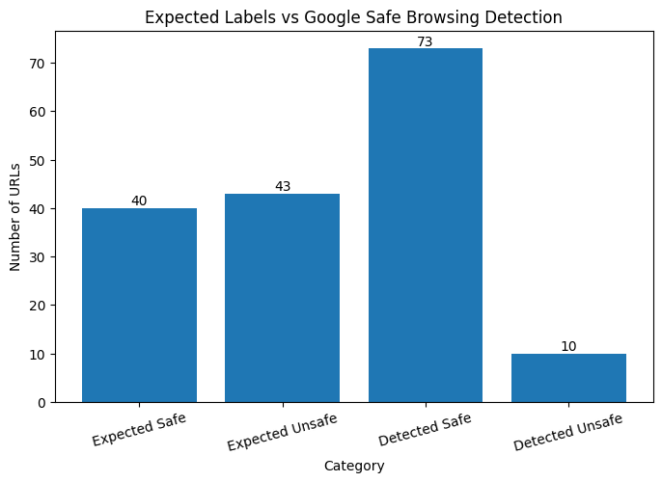
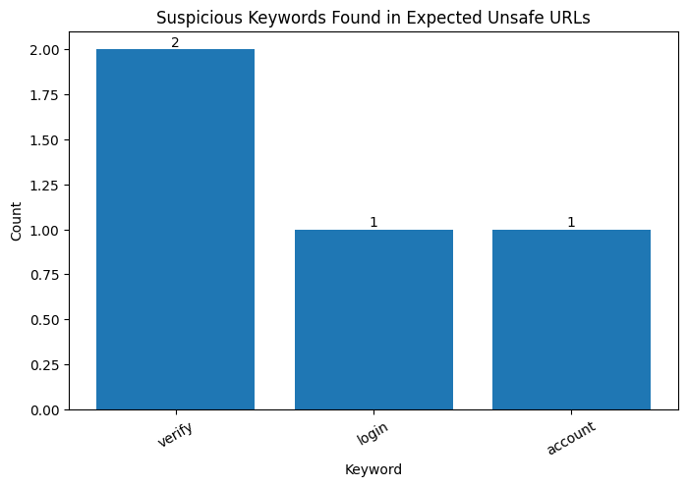
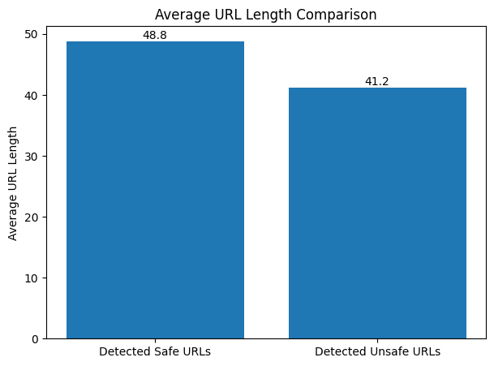
Results
What the Graphs Tell Us
There is a clear gap between expected unsafe URLs and those detected by the API
Many unsafe URLs were incorrectly marked as safe
Key Observations
Phishing is the most common type of threat
Suspicious keywords appear frequently in unsafe URLs
Detection depends on known threat databases
How This Can Be Improved
Use multiple detection tools instead of one API
Work with a larger dataset
Apply machine learning to detect unknown patterns

